Slide 1
Cognitive Computation Group Curator Overview December 3, 2013
http://cogcomp.cs.illinois.edu

Slide 2
Available from CCG in Curator
Tokenization/Sentence Splitting
Part Of Speech
Chunking
Lemmatizer
Named Entity Recognition
Coreference
Semantic Role Labeling
Wikifier
3rd party syntactic parsers:
Charniak
Stanford (dependency and constituency)

Slide 3
Academic research use of NLP tools
Find tools written in the language you’re programming with, e.g. python, Java, perl, c++…
…with a nice API
public class myApp
{
POSTagger tagger;
….
public Result doSomething( String text )
{
List< Pair< String, String > taggedWords = tagger.tag( text );
…
}

Slide 4
Using NLP tools (cont’d)
…OR maybe, it’s written in Ocaml and only runs from the command line and writes to a file…
… so write a shell script that runs the first tool and pipes its output to your tool…
…and write a parser to map from that output to your data structures…
…or maybe you could learn Ocaml and write a web service wrapper...
Generally, people either…
tend to use a lot of File I/O and custom parsing -- cumbersome and usually extremely non-portable.
Use a specific package in a specific language (e.g. NLTK), and stick to it.
Write all their own tools.

Slide 5
The growing problem…
Usually, complex applications like QA benefit from using many NLP tools.
For many tasks – e.g. POS, NER, syntactic parsing – there are numerous packages available from various research groups.
But they use different languages
…and different APIs…
…and you don’t know for certain which tool of each type would be the best, so you’d like to try out different combinations…
…and as tools get more sophisticated, they tend to need more memory.
CCG tools: Old NER: 1G; Old Coref: 1G; SRL/Nom: 4G each; new NER: 6-8G; Wikifier: 8G….
Even if they are all in Java, you may not have a machine that can run them all in one VM.

Slide 6
Curator

Slide 7
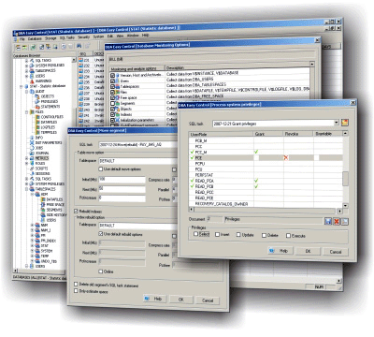
Curator
NER
Curator
SRL
POS, Chunker
Cache

Slide 8
What does the Curator give you?
Supports distributed NLP resources
Single point of contact
Single set of interfaces
Common interchange format (Thrift)
Code generation in many programming languages (using Thrift)
Programmatic interface
Defines set of common data structures used for interaction
Caches processed data
Enables highly configurable NLP pipeline
Overhead: Annotation is all at the level of character offsets: Normalization/mapping to token level required
Need to wrap tools to provide requisite data structures

Slide 9
Getting Started With the Curator
http://cogcomp.cs.illinois.edu/curator
Installation:
Download the curator package and uncompress the archive
Install prerequisites: thrift, apache ant, boost, mongodb
Run bootstrap.sh
The default installation comes with the following annotators (Illinois, unless mentioned):
Sentence splitter and tokenizer
POS tagger
Lemmatizer
Shallow Parser
Named Entity Recognizer
Coreference resolution system
Stanford and Charniak parsers
Semantic Role Labeler (+ Nominalized verb RL)

Slide 10
Basic Concept
Different NLP annotations can be defined in terms of a few simple data structures:
Record: A big container to store all annotations of a text
Span: A span of text (defined in terms of characters) along with a label (A single token, or a single POS tag)
Node: A Span, a Label, and a set of children (indexes into a common list of Nodes)
Labeling: A collection of Spans (POS tags for the text)
Trees and Forests: A collection of Nodes (Parse trees)
Clustering: A collection of Labelings (Co-reference)
Note: spans use one-past-the-end indexing
“The” at beginning of sentence has character offsets ‘0,3’

Slide 11
Spans, Labelings, etc.
The Span is the basic unit of information in Curator’s data structures.
A Span has a label, a pair of offsets (one-past-the-end – see the Labeling/Span example further on), and a key/value map to contain additional information
While the different data structures (Labelings, Trees, etc.) are provided with specific uses in mind, there are no specific constraints on how any given application represents its information
Part of Speech will probably use the Span label to store POS information, but the key/value map could be used instead
Coreference may store additional information about mentions in a mention chain in their key/value maps

Slide 12
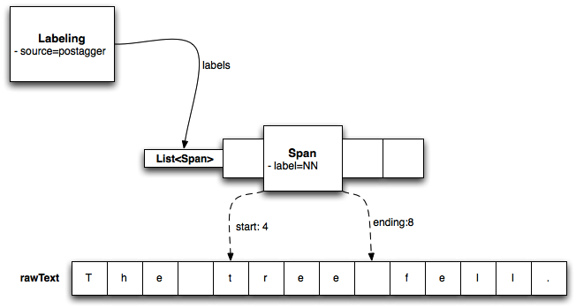
Example of a Labeling and Span
The tree fell.

Slide 13


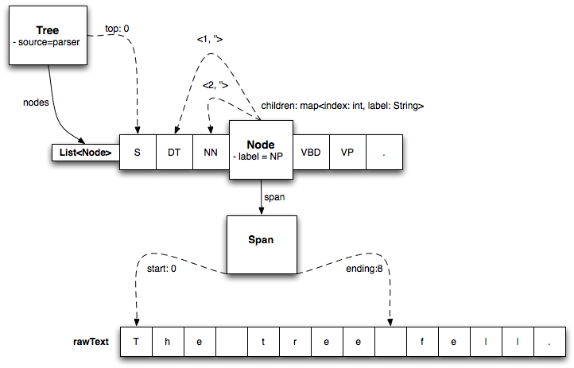
Example of a Tree and Node
The tree fell.

Slide 14

Example of a Clustering
John saw Mary and her father at the park. He was alarmed by the old man’s fierce glare.
Labeling 1: [E1; 0,4 (John)], [E1; 43,45 (He)]
Labeling 2: [E2; 10,14 (Mary)], [E2; 20,23 (her)]
Labeling 3: [E3; 20, 29 (her father)], [E3; 59, 61 (the old man)]

Slide 15
Using Curator for Flexible NLP Pipeline
http://cogcomp.cs.illinois.edu/curator/demo/
Setting up:
Install Curator Server instance
Install components (Annotators)
Update configuration files
Use:
Use libraries provided: curatorClient.provide() method
Access Record field indicated by Component documentation/configuration

Slide 16
Record Data Structure
struct Record {
/** how to identify this record. */
1: required string identifier,
2: required string rawText,
3: required map<string, base.Labeling> labelViews,
4: required map<string, base.Clustering> clusterViews,
5: required map<string, base.Forest> parseViews,
6: required map<string, base.View> views,
7: required bool whitespaced,
}
rawText contains original text span
Annotators populate one of the <abc>Views, assign a unique identifier (specified in configuration file)

Slide 17
Annotator Example: Parser
Will populate a View, named ‘charniak’
Curator will expect a Parser interface from the annotator
Client will expect prerequisites to be provided in other Record fields
Specified via Curator server’s annotator configuration file:
<annotator>
<type>parser</type>
<field>charniak</field>
<host>mycharniakhost.uiuc.edu:8087</host>
<requirements>sentences:tokens:pos</requirements>
</annotator>

Slide 18
Using Curator (Java) snippet <1>
public void useCurator( String text ) {
// First we need a transport
TTransport transport = new TSocket(host, port );
// we are going to use a non-blocking server so need framed transport
transport = new TFramedTransport(transport);
// Now define a protocol which will use the transport
TProtocol protocol = new TBinaryProtocol(transport);
// instantiate the client
Curator.Client client = new Curator.Client(protocol); transport.open();
Map<String, String> avail = client.describeAnnotations();
transport.close();
for (String key : avail.keySet())
System.out.println(``\t'' + key + `` provided by '' +
avail.get(key));
boolean forceUpdate = true; // force curator to ignore cache
…

Slide 19
Curator snippet (Java) <2>
…
// get an annotation source named as 'ner' in curator annotator
// configuration file
transport.open();
record = client.provide( “ner‘”, text, forceUpdate);
transport.close();
for (Span span : record.getLabelViews().get(“ner”).getLabels()) { System.out.println(span.getLabel() + `` : '' + record.getRawText().substring(span.getStart(), span.getEnding()));
}
...
}

Slide 20
Curator snippet (php) <1>
function useCurator() {
// set variables naming curator host and port, timeout, and text ...
$socket = new TSocket($hostname, $c_port);
$socket->setRecvTimeout($timeout*1000);
$transport = new TBufferedTransport($socket, 1024, 1024);
$transport = new TFramedTransport($transport);
$protocol = new TBinaryProtocol($transport);
$client = new CuratorClient($protocol);
$transport->open();
$record = $client->getRecord($text);
$transport->close();
…

Slide 21
Curator snippet (php) <2>
…
foreach ($annotations as $annotation) {
$transport->open();
$record = $client->provide($annotation, $text, $update);
$transport->close();
}
foreach ($record->labelViews as $view_name => $labeling) {
$source = $labeling->source;
$labels = $labeling->labels;
$result = ``'';
foreach ($labels as $i => $span) {
$result.= ``$span->label;'';
...
}
...

Slide 22
Benefits
From the user’s (i.e., developer of complex text processing applications)’ perspective,
Programmatic interface in their language of choice
Uniform mechanism for accessing a wide variety of NLP components
Caching of annotations, which can be shared across a group
Distribution of memory-hungry components across different machines, but with one point of access
For the more adventurous, an extensible framework that can be changed via the specification of the underlying Thrift files

Slide 23
Edison
A Java library by Vivek Srikumar of CCG that…
Simplifies access to Curator
Defines useful NLP-friendly data structures
Provides code for a lot of common NLP tasks, e.g. feature extraction, calculation of performance statistics, …
http://cogcomp.cs.illinois.edu/page/software_view/Edison
The link above provides examples for using Edison and Curator together

